Slide 1
120 YEARS OF OLYMPIC HISTORY ANALYZE AND INSIGHTS
Laura Le

Slide 2

WHAT IS THE DATASET ABOUT
Source: https://www.kaggle.com/heesoo37/120-years-of-olympic-history-athletes-and-results
This dataset includes all the modern Olympic Games from Athens 1896 to Rio 2016. It tells us how the Olympics have evolved over time

Slide 3
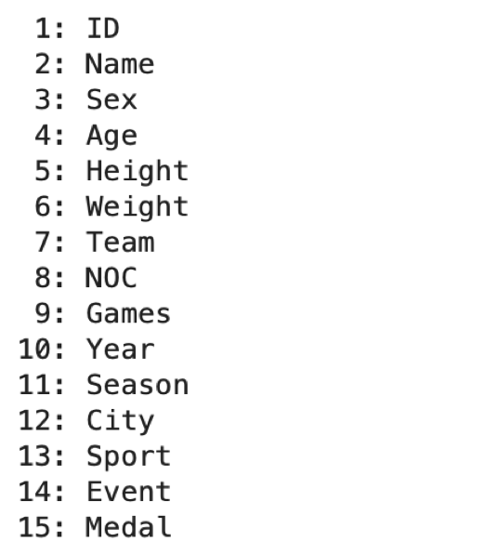
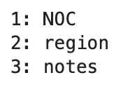
DATASET INFORMATION
Athlete_events.csv
15 columns 271117 rows
noc_regions.csv
3 columns 230 rows

Slide 4
DATA CONCERNS & WRANGLING
CONCERNS
SOLUTIONS
Duplicate information : Column ‘Games’ contains year and season, while the dataset also has columns ‘Year’ and ‘Season’.
Insufficient information: Column ‘City’ provides hosting city but no hosting country.
Data type: All data types in original csv file are string.
Missing values - NA value in ‘Age’, ‘Weight’ and ‘Height’.
Drop col: “Games”.
2. Create new “Country” column and drop "City" column.
3. Converted dataset to correct data type. 4. Keep the values and converted ‘NA’ to 0.

Slide 5
STAR SCHEMA:
Demographic
ID
KEY
NAME
SEX
AGE
TEAM
REGION
NOTES
Hosting Country
KEY
YEAR
SEASON
COUNTRY
Olympic
NOC
MEDAL
HOSTING_COUNTRY_KEY
DEMOHRAPHIC_KEY
PHYSICAL_CHARACTERISTIC_KEY
SPORT_KEY
Physical Characteristic
KEY
WEIGHT
HEIGHT
Sport
KEY
SPORT
EVENT

Slide 6
EXPLORING DATA
COMPARE FEMALE & MALE ATHLETES PERFORMANCE
Number , Increase percentage
attendants, gained medals.
PHYSICAL CHARACTERISTICS OF TOP BEST ATHLETES IN 5 SPORTS.
Height
Weight
RELATIONSHIP BETWEEN HOST COUNTRIES & ATHLETES’ PERFORMANCE
Performance at athletes’ countries
Performance at other countries

Slide 7
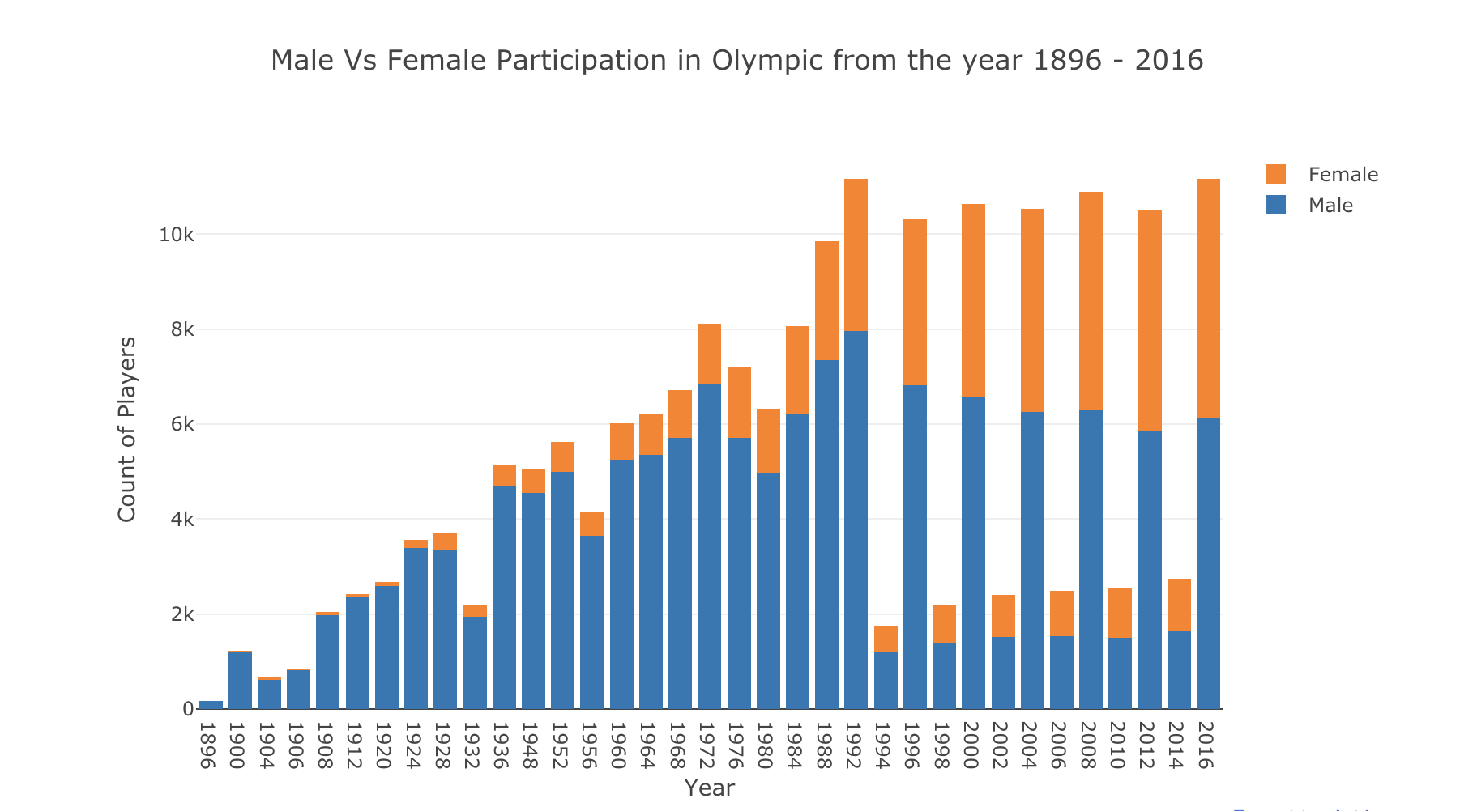
1. COMPARE FEMALE & MALE ATHLETES’ PERFORMANCE

Slide 8
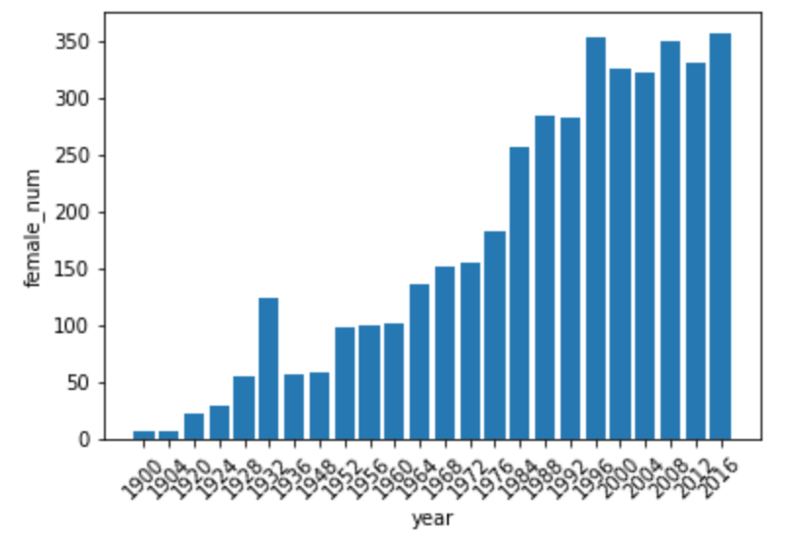
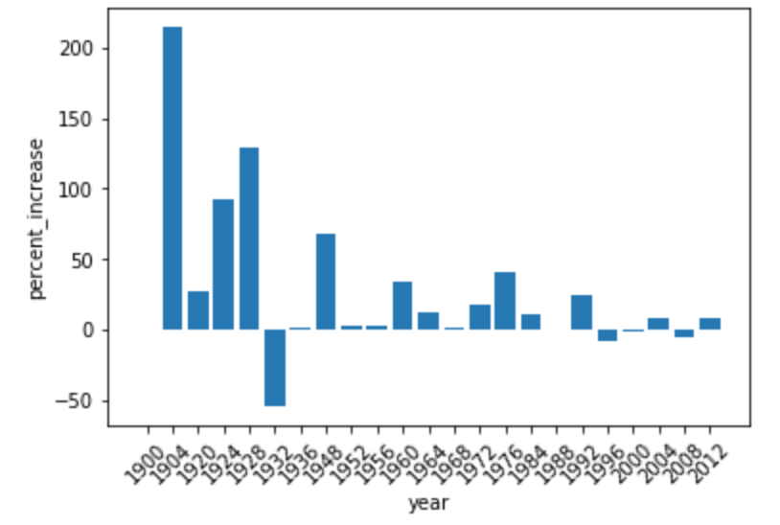
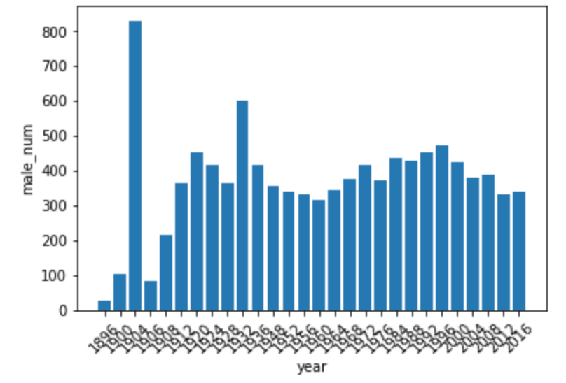
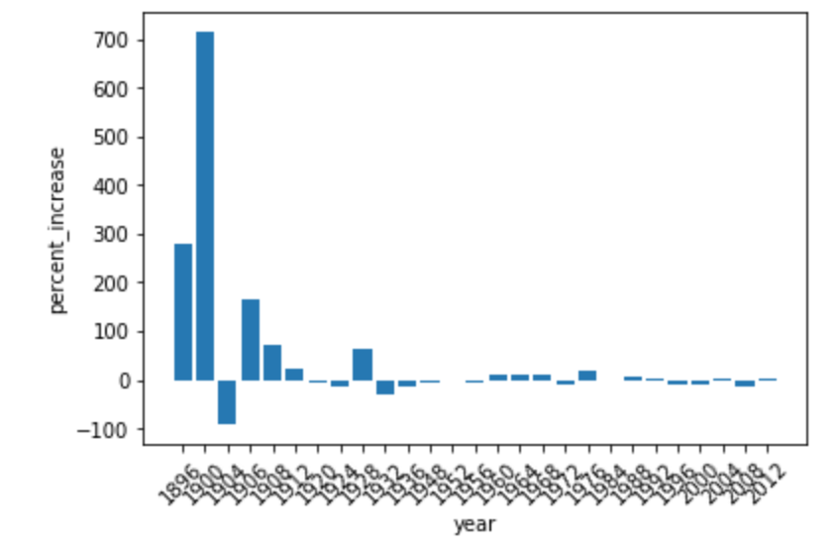
COMPARE PARTICIPATION RATE
The number of female athletes
Increase percentage of female athletes
The number of male athletes
Increase percentage of male athletes

Slide 9
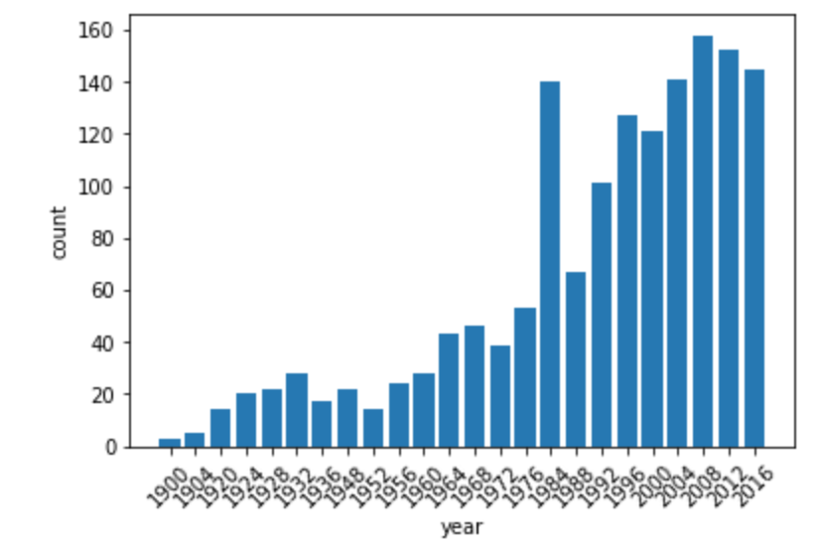
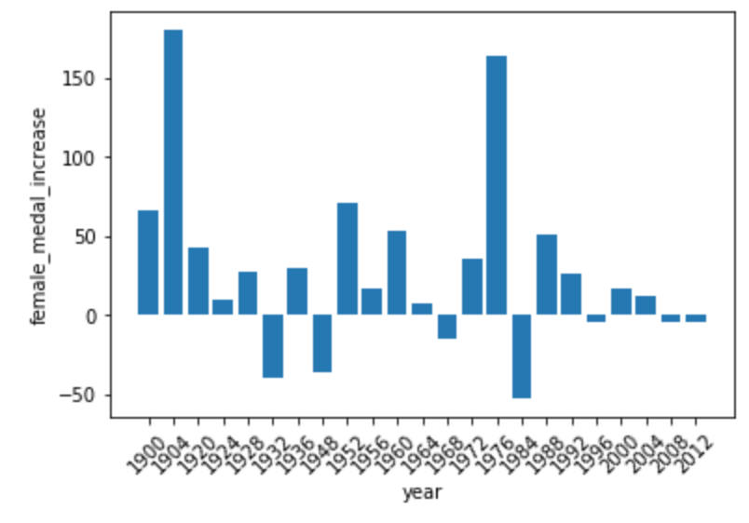
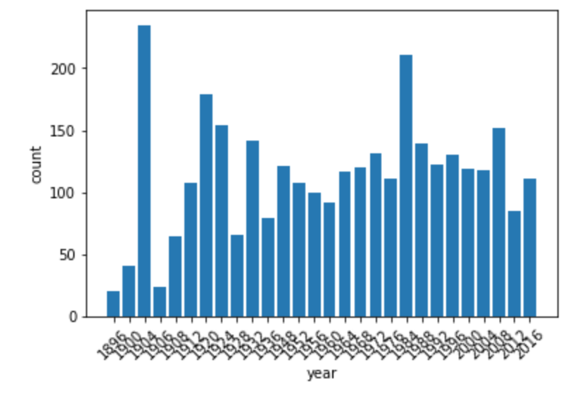
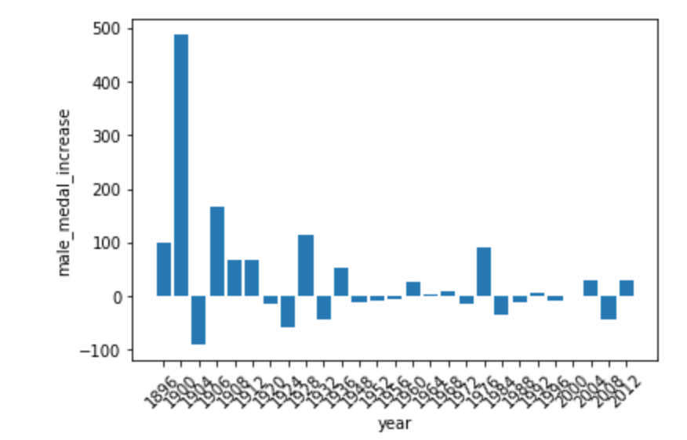
COMPARE GAINED MEDALS
Female athletes’ medals
Increase percentage of medals won by females
Male athletes’ medals
Increase percentage of medals won by males

Slide 10
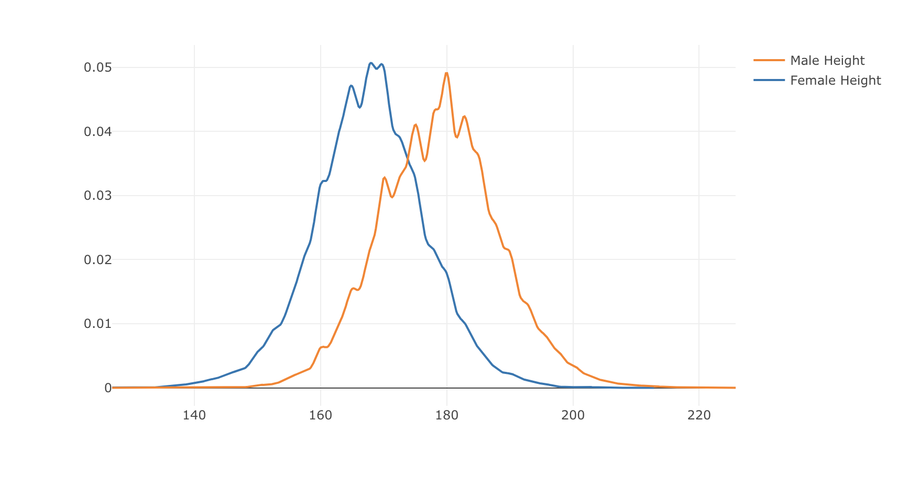
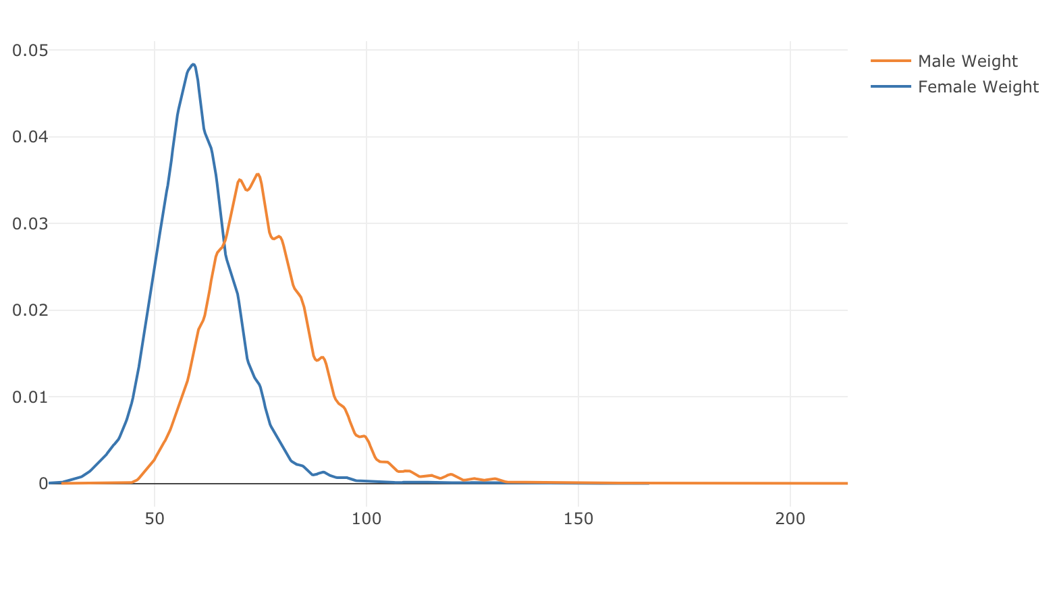
2. PHYSICAL CHARACTERISTICS OF TOP BEST ATHLETES

Slide 11
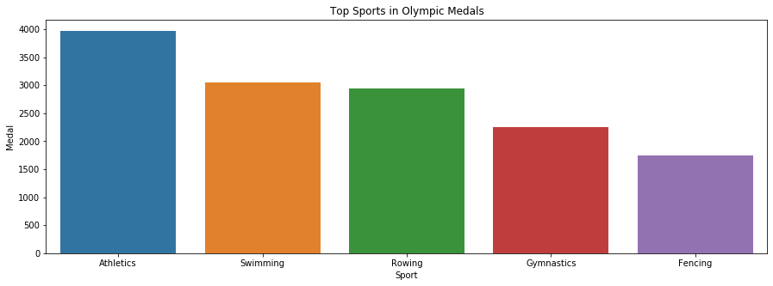
TOP 5 MOST POPULAR SPORTS IN OLYMPIC

Slide 12
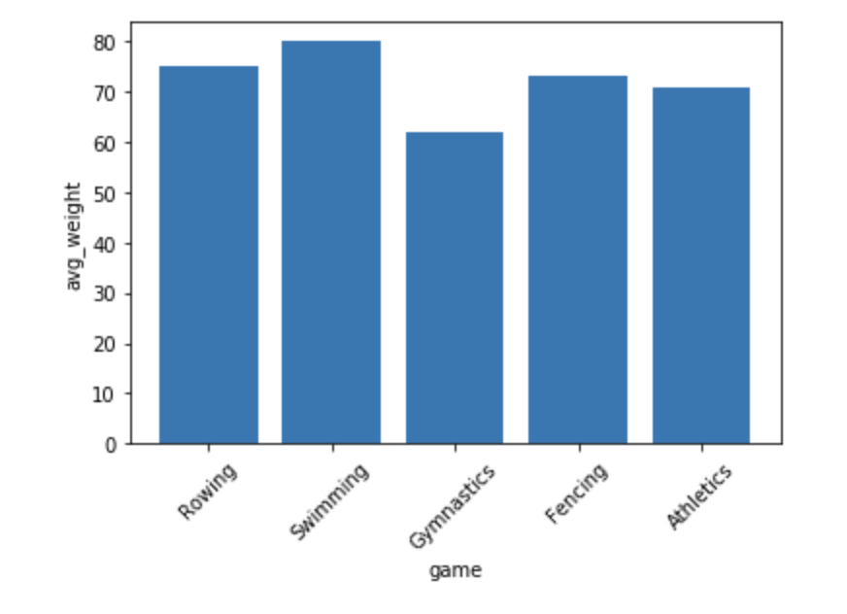
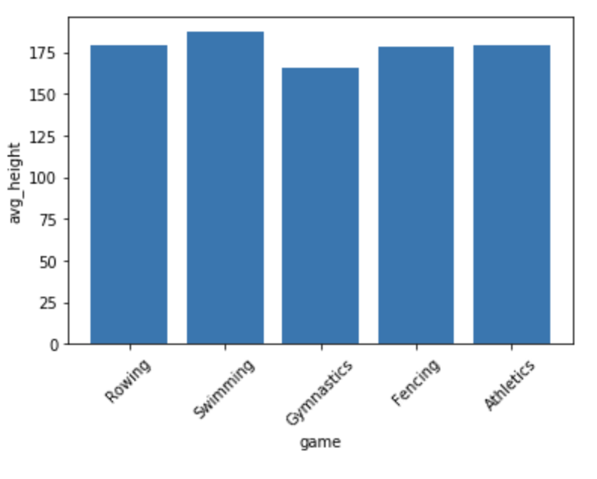
COMPARE ATHLETES’ HEIGHT AND WEIGHT IN DIFFERENT SPORTS

Slide 13
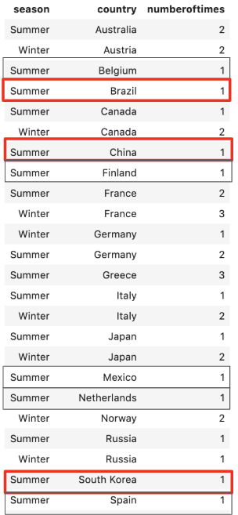
3. RELATIONSHIP BETWEEN HOST COUNTRIES & ATHLETES’ PERFORMANCE
3 COUNTRIES HOSTED OLYMPIC GAMES
ONE TIME:
China: Summer 2008
South Korea: Summer 1988
Brazil: Summer 2016

Slide 14
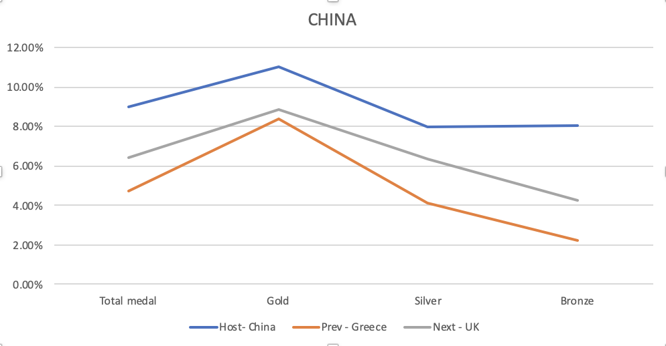
CHINA

Slide 15
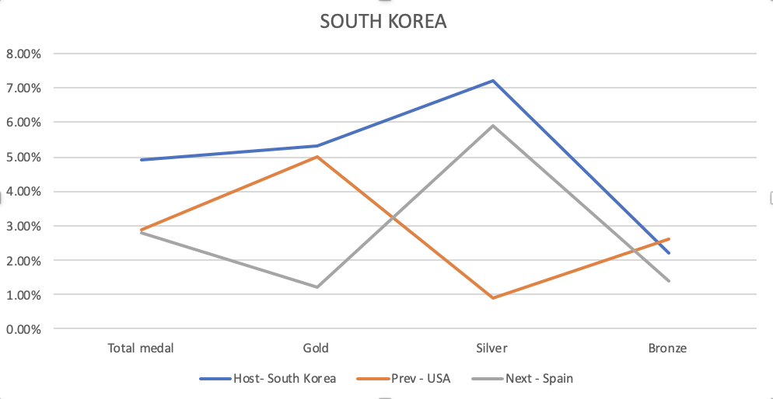
SOUTH KOREA

Slide 16
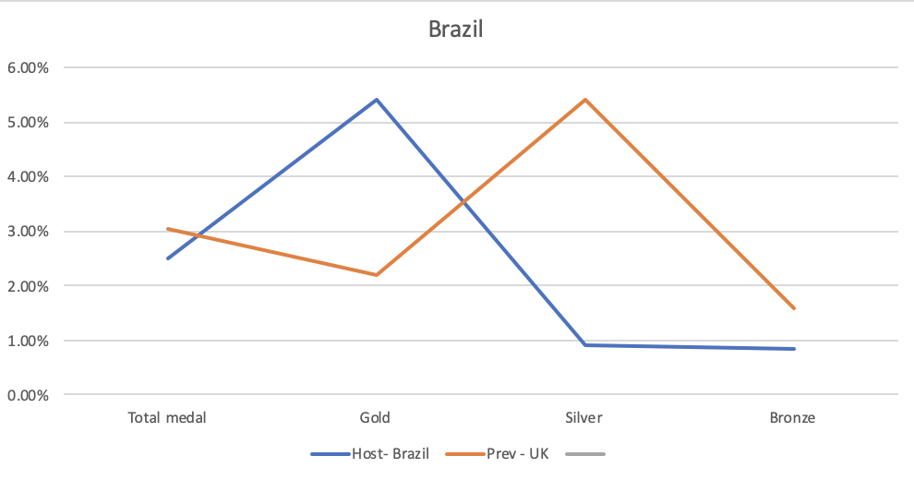
BRAZIL

